Slide 1


Subject:
Web Development
NORTON
UNIVERSITY
Lecturer:
Keo Lakhena
Assignment:
Fashion Shop
2025-2026

Slide 2
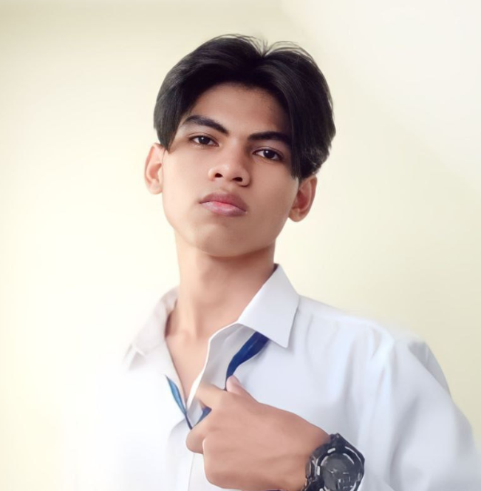
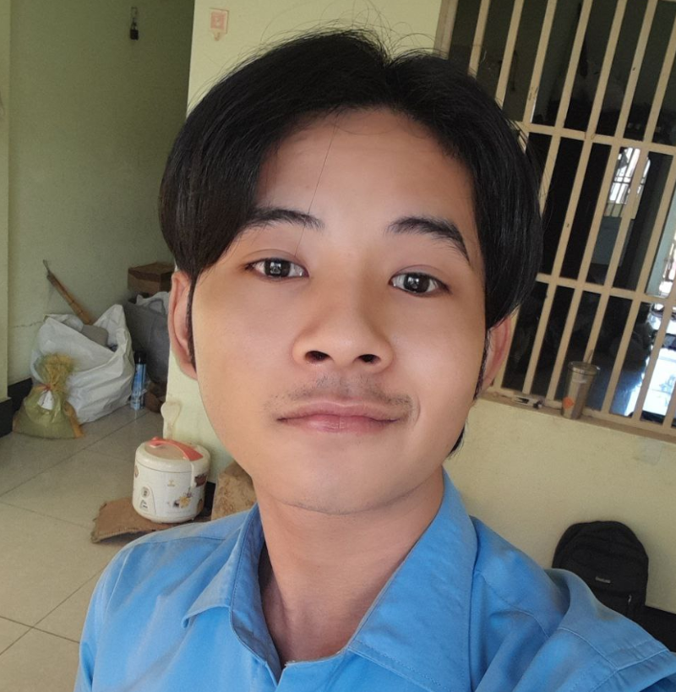
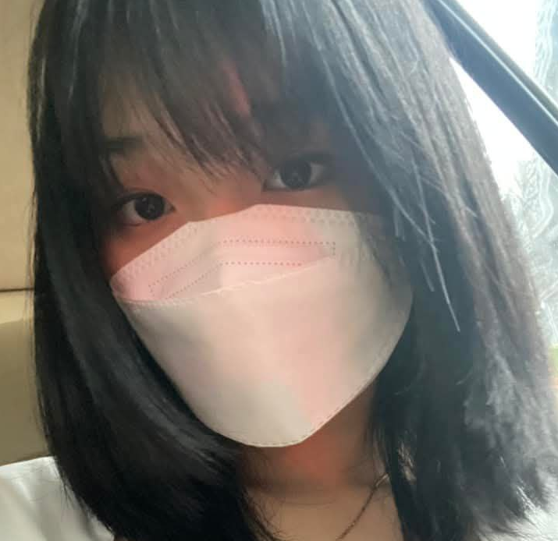

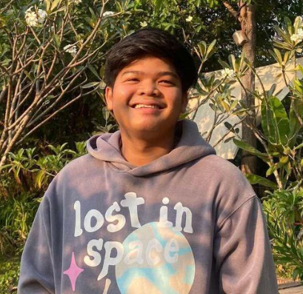
TEAM(2nd)
NORTON
UNIVERSITY
សឺន មុន្នីវិសើ
ផល់ រ៉ាភូ
ណៅ​ ចាន់វាសនា
B20243219
B20235159
B20243398
លី​ សុគ្រី​
អែម លីហៀង
B20242886
B20243381
2025-2026

Slide 3
NORTON
UNIVERSITY
Contents
I/ The topic brand and title
II/ Purpose of website
III/ Needs
IV/ Code and Material
V/ Website Showcase
VI/ Conclusion
2025-2026

Slide 4
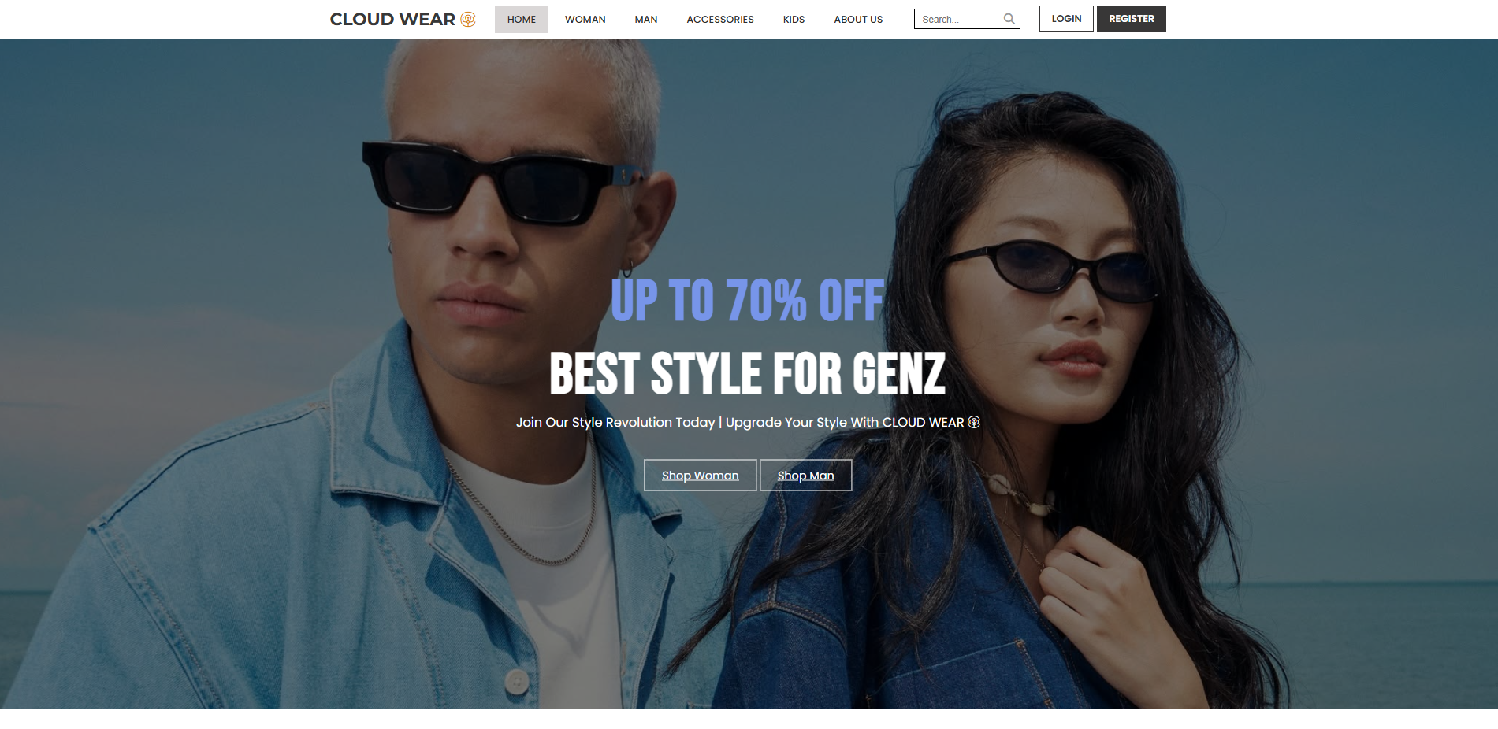
I/ The topic brand and title
NORTON
UNIVERSITY
1/ Fashion shop
2/ Cloud-Wear

Slide 5
II/ Purpose of Website
NORTON
UNIVERSITY
1/ Showcasing and selling clothing and accessories for men and women
2/ Promoting special deals or discounted items via the Homepage
3/ Allowing customer interaction through login/register features
4/ Providing company contact information for inquiries or customer services
5/ Offering a structured and categorized fashion experience by gender and product type

Slide 6
III/ Needs
NORTON
UNIVERSITY
1/ Functionality
2/ Needed Pages
3/ Items
4/ Information
5/ Model

Slide 7
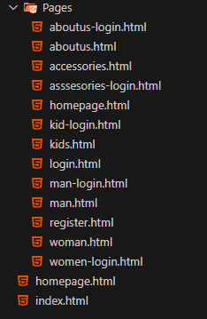



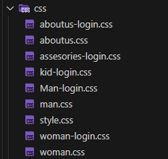
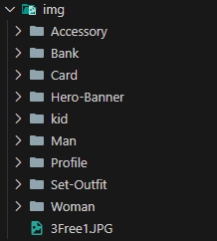

IV/ Code and Material
NORTON
UNIVERSITY

Slide 8
V/ Conclusion
NORTON
UNIVERSITY
Our fashion website, Cloud-Wear, provides a modern, user-friendly platform to browse, shop, and interact.
It is designed to be fully functional, visually appealing, and responsive across devices.
It is designed to be fully functional, visually appealing, and responsive across devices.
We look forward to enhancing the site with more advanced features in the future.

Slide 9

V/ Conclusion
NORTON
UNIVERSITY
Thank you!!

